Slide 1

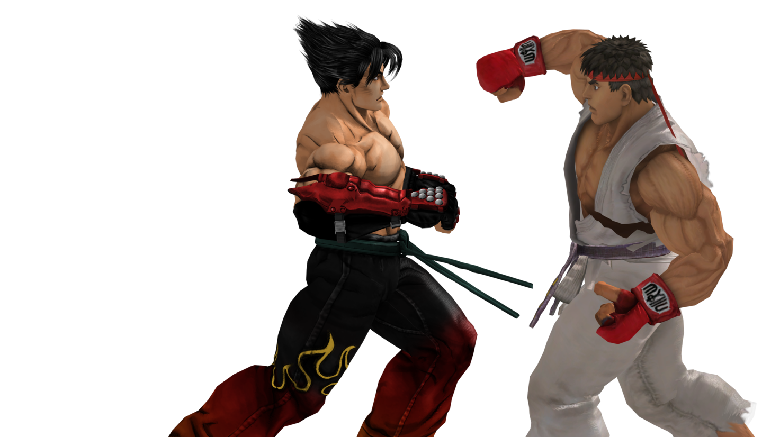
THE IRON THRONE

Slide 2


THE IRON THRONE
A 2D Fighting Game in SFML
TEAM:
Sandesh Pokhrel 075BCT076
Santosh Pangeni 075BCT082
Subodh Baral 075BCT088

Slide 3
OBJECTIVES:
Understanding the concepts of C++ practically to build a software.
Understanding the integration of SFML into IDEs.
Understanding the implementation of SFML for shape rendering, textures, animation, music etc.
Understanding the basic workflow of a game.
To make a base for handling complex software engineering projects in future.
To develop a game with user friendly interface.

Slide 4
Development Environment:
Tools and Libraries:
C++ Compiler
Standard C++ Libraries
SFML (Simple Fast Multimedia Library )
Environment: CODE::BLOCKS

Slide 5
:
INTRODUCTION:
A 2D animated fighting game made using SFML.
Two players engage in hand to hand combat.
Offers both single player as well as multiplayer interactive game mode.
Object of the game is to diminish opponent’s health with strikes and nullify the health bar to win the round.
Every level is a best of 3 rounds and each round ends with the death of one player.
In single player mode, difficulty rises with levels and the arenas changes at each level.
Multiplayer Mode is single round match and the last man standing wins.

Slide 6
GAME STATES
The game passes through a series of events called states such as main menu, options , mode select before the gameplay begins.
Why states ?? Why not jump to game ??
All modern games available uses states throughout the game to keep the player engaged in the game.
States make the game user friendly and much similar to real games we actually play.

Slide 7
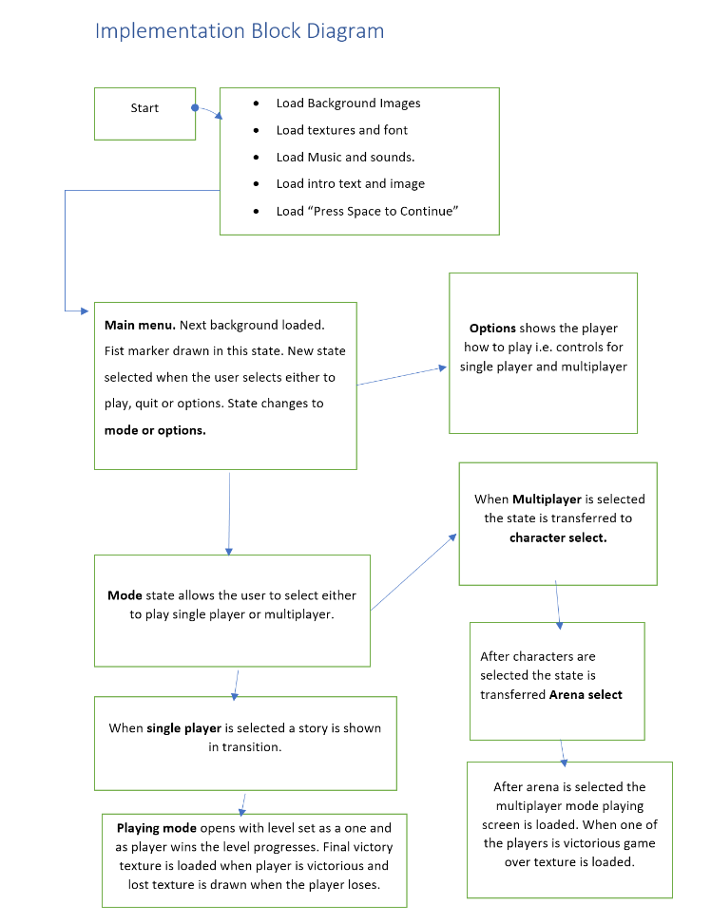

Slide 8

INTRO PAGE OF THE GAME
*background music starts

Slide 9
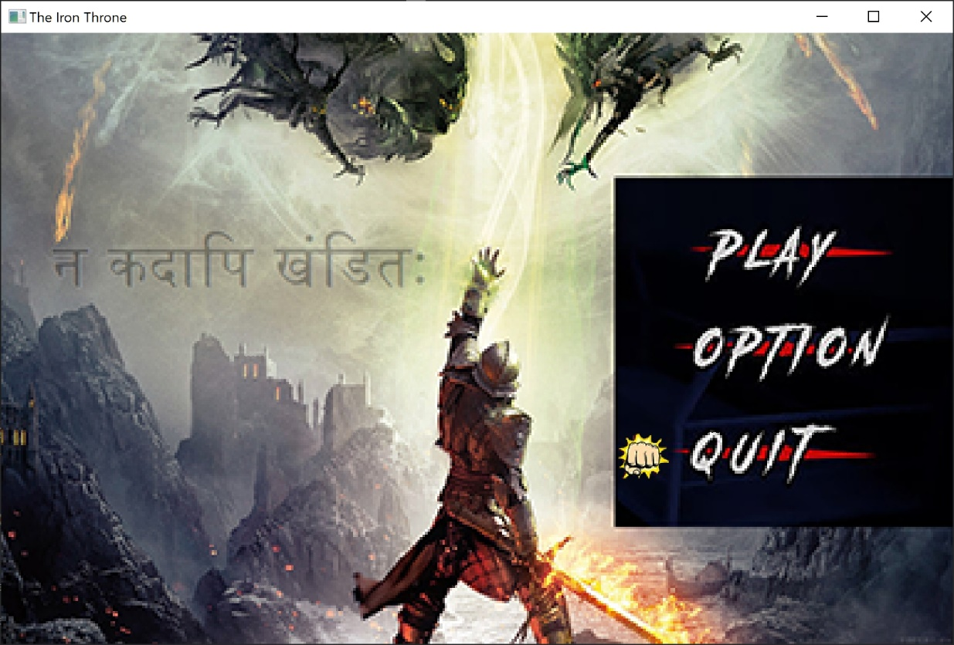
MAIN-MENU PAGE
*music continues

Slide 10
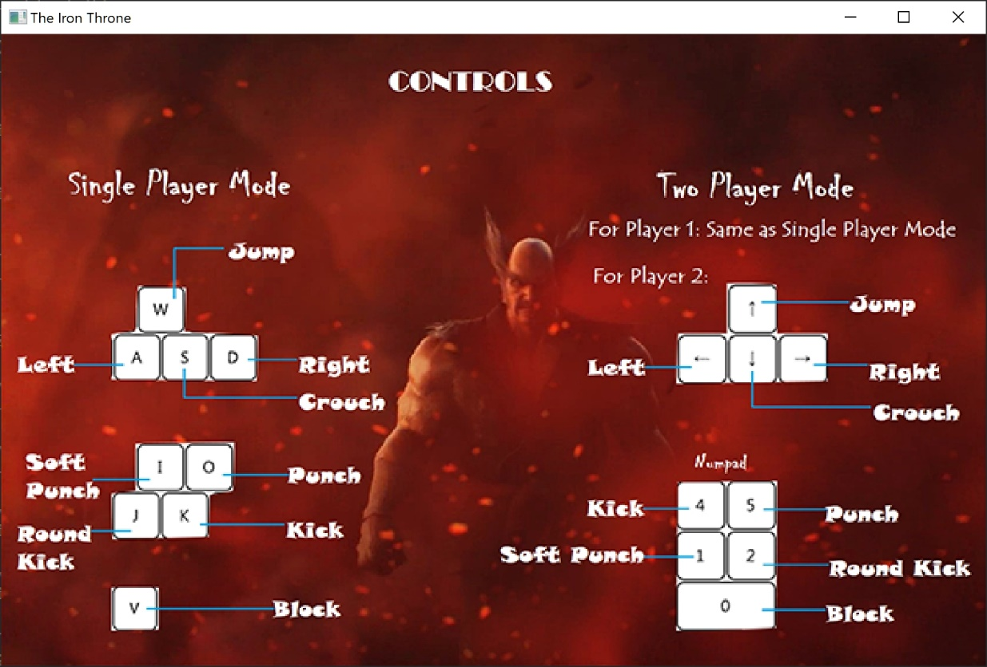
OPTIONS PAGE WITH CONTROLS
*music continues

Slide 11
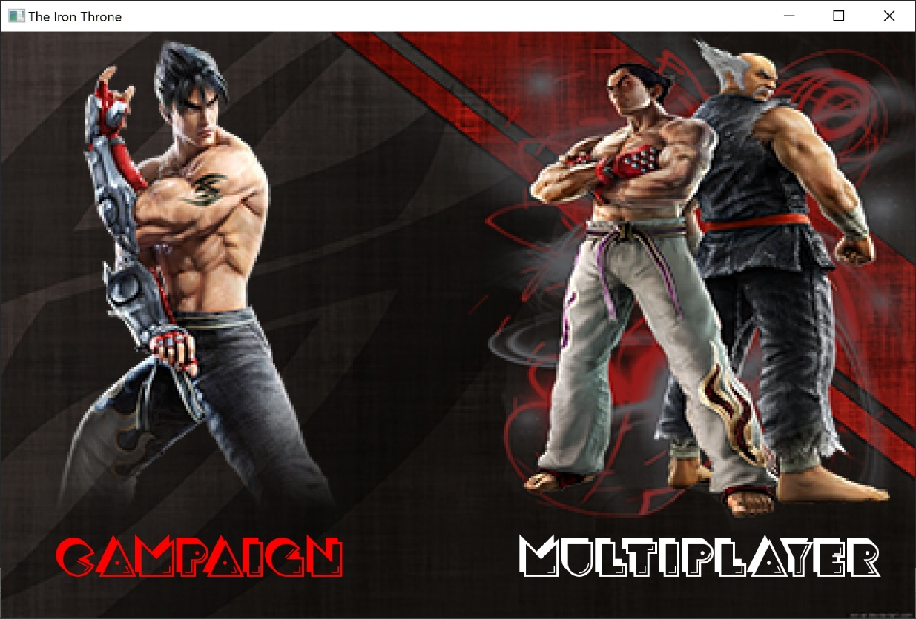
MODE SELECT PAGE
*music continues

Slide 12
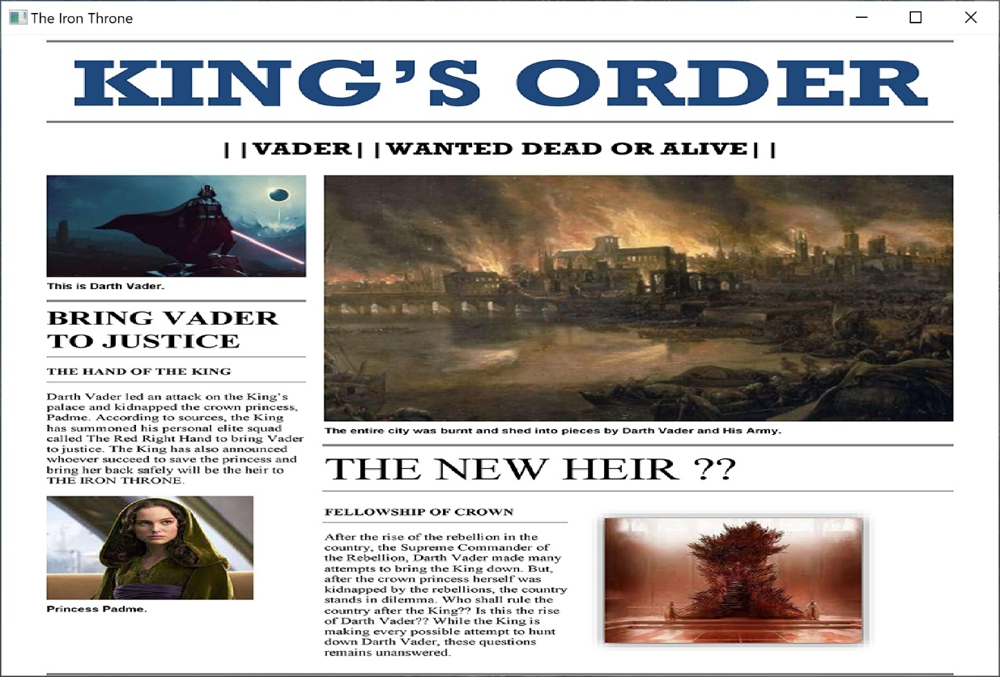
THIS IS STORY.. FOR CONTENT SEEKING GAMERS
*deep music starts

Slide 13
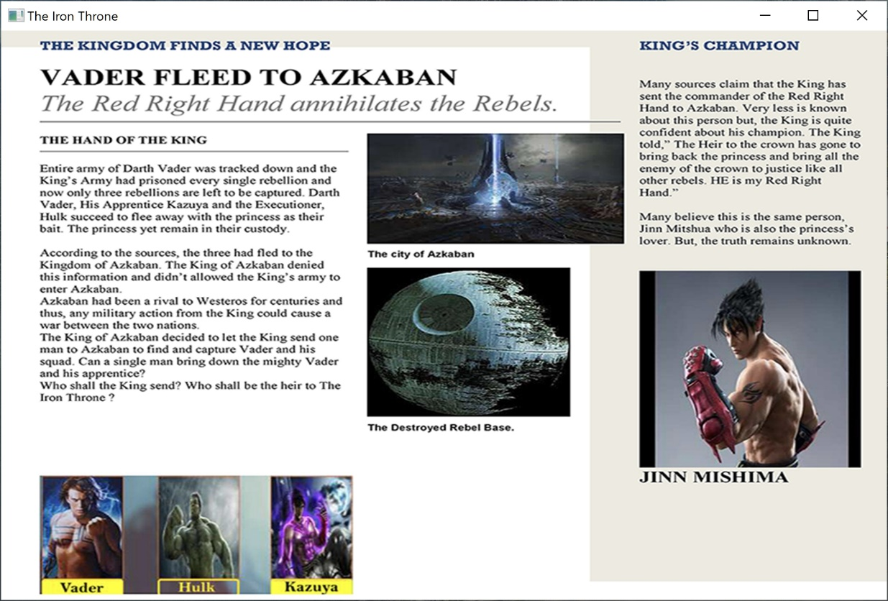
STORY CONTINUES

Slide 14
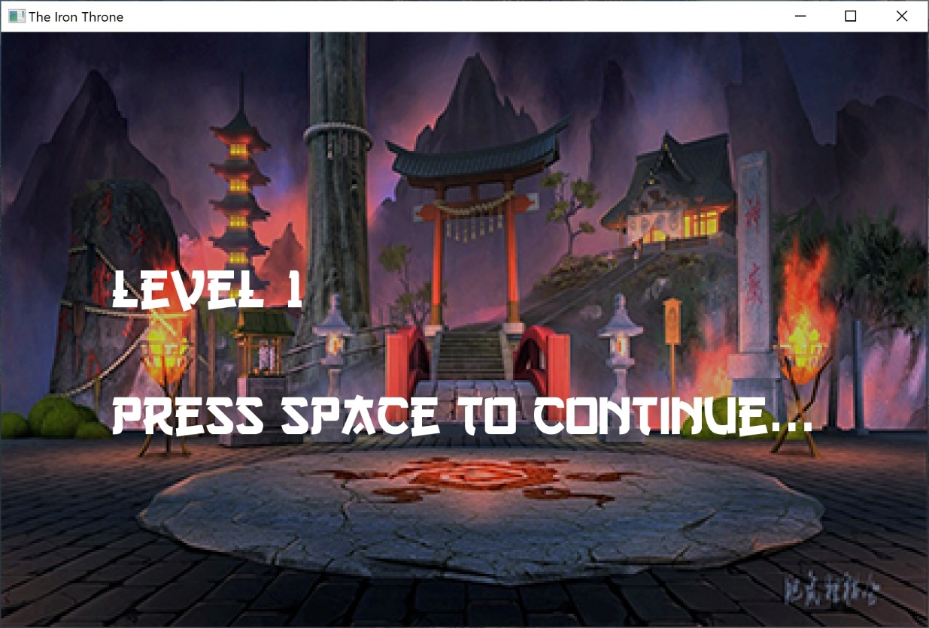
LEVEL DISPLAY BEFORE GAMEPLAY BEGINS
*arena music starts

Slide 15
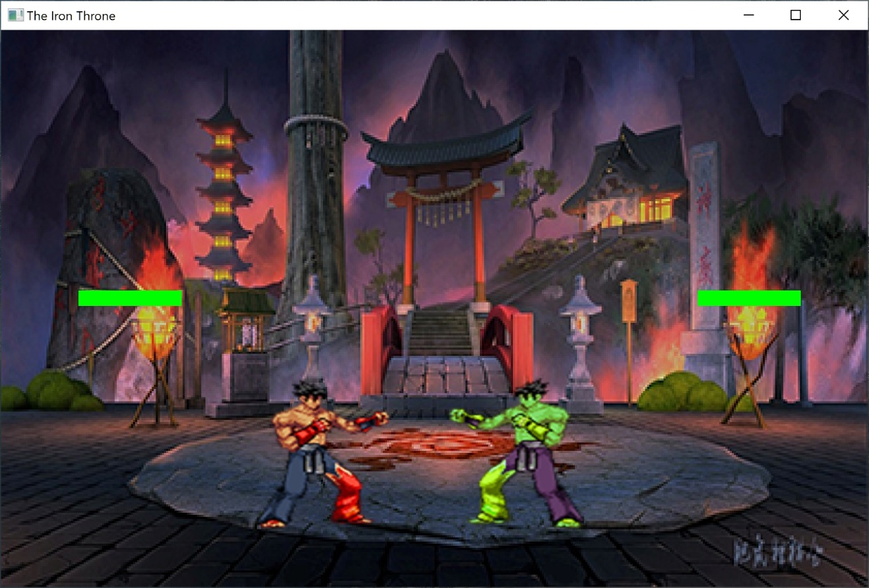
FINALLY, TO THE GAME
*arena music continues

Slide 16
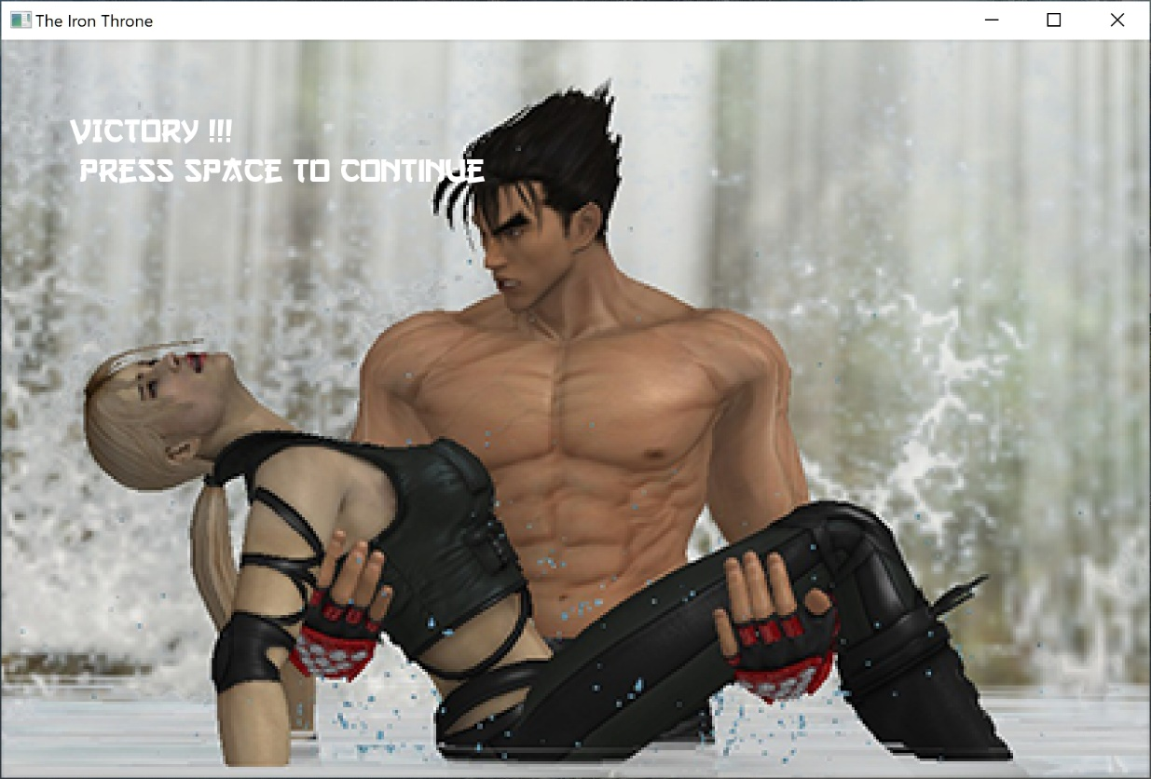
AFTER THE STORY COMPLETES (WHICH IS SAVING THE PRINCESS)
*victory laughs starts

Slide 17
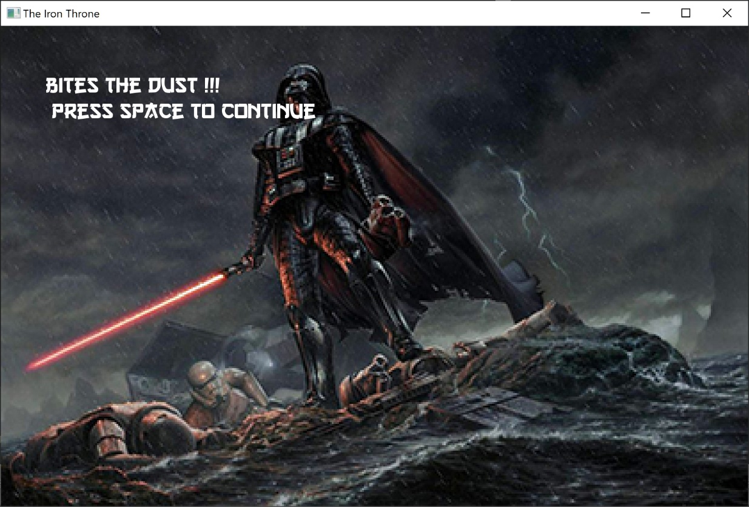
SOMETIMES WE LOSE.
Game lost page in single player

Slide 18
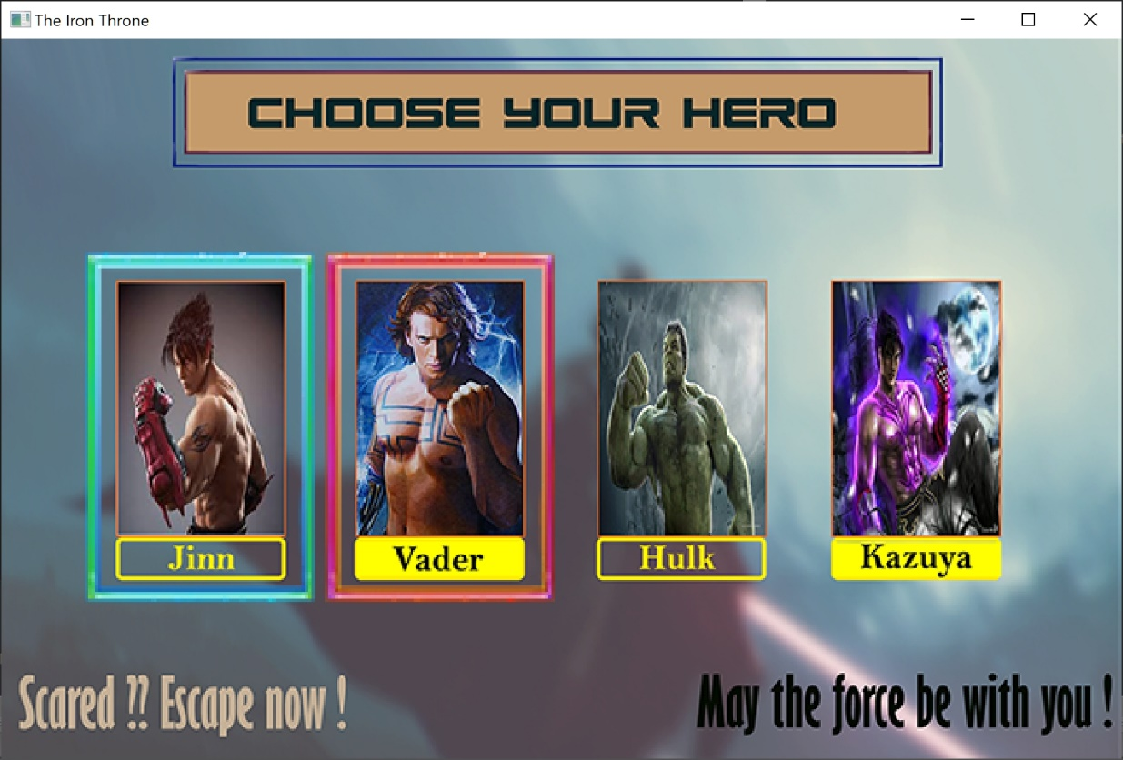
SWITCH TO MULTIPLAYER MODE
Character select mode in multiplayer
*Deep music starts

Slide 19
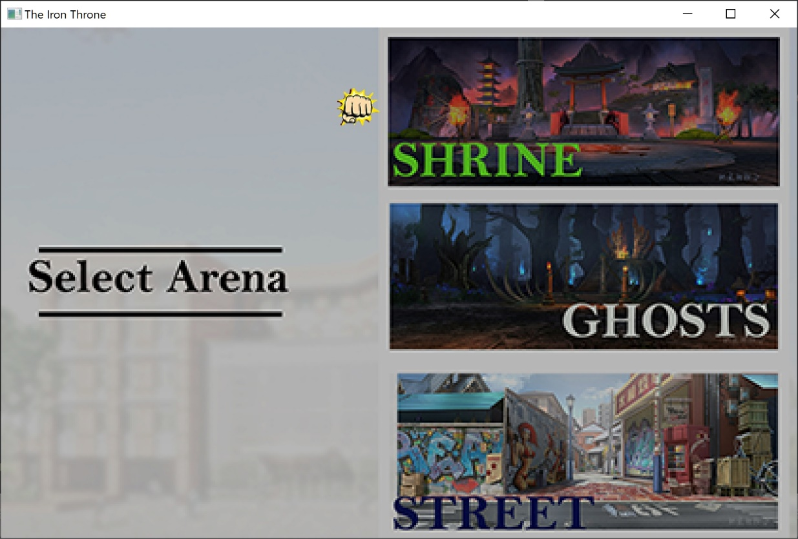
ARENA SELECT (ONLY IN MULTIPLAYER)

Slide 20
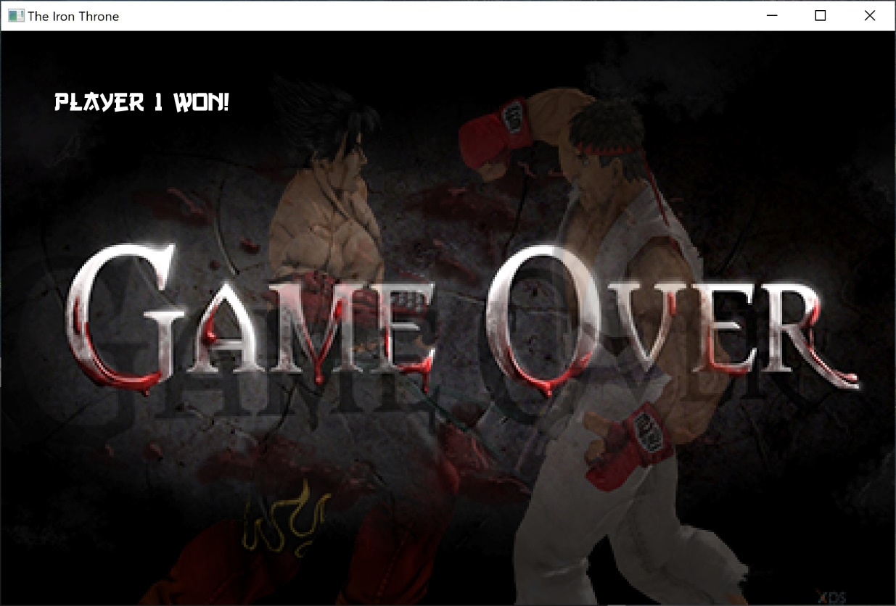
GAME OVER (MULTIPLAYER)

Slide 21
CLASSES INVOLVED:
Game
Player
Anime
Opponent
Music

Slide 22
GAME:
-Basically the main engine of the game
-Loads resources for all the states, creates almost all objects involved.
-Sets textures to players objects and arenas
-Updates the game according to inputs and draws all events on screen.
-the game update holds the entire game flow from beginning to the end.

Slide 23
PLAYER:
-Controls the entire actions of the player
-Creates animations of players and updates the animations
Checks player’s collision and updates health of the player with opponent’s hits
-Automatic action of cpu controlled player in singles mode
-signals game to reset with death of player and to level up with death of opponent.

Slide 24
ANIME:
Responsible for loading single image from spritesheets
Performs all the animations of players with animation update function.
Punching, kicking ,walking, knocked down all are controlled by the anime object of player.

Slide 25
MUSIC:
-Includes SFML sound class
loads music from the file
Responsible for all the music throughout the game
Controls collision music, player’s sound and background music
-Its functions switches the music or sound effects playing in the game with change in states.

Slide 26
OPPONENT:
Derived from player, it contains all the attributes of the player.
Controls multiplayer mode by controlling player2 actions.
Its additional function allows to provide input to the opponent player as well.
Controls health, actions and movement of player2 in multiplayers.

Slide 27
METHODOLOGY:
-Making the project proposal.
-Exploring the references and initial coding.
-Coding the program.
-Execution and testing the program.
-Debugging.
-Program documentation.

Slide 28
PROBLEM FACED
-Understanding the Game Development Architecture.
-Getting Proper Resources for Game Development.
-Linker Errors was the most common bug we faced.
-Making a working Collision detection system.
-Self controlling player with AI in singles mode was also a headache

Slide 29
SOLUTIONS
-John Horton’s book on sfml was the key for understanding game architecture.
-We downloaded images from internet and created the required spritesheets on our own with photoshop.
- Downloaded music and other graphics resources from internet.
-We decided to make a template of the SFML linked C++ file and then we didnt have linker errors coming up every time.
The AI problem was never fully solved. So, we designed a virtual algorithm ourselves to solve the problem.

Slide 30
APPLICATION(PRIMARY):
For an addictive easy to grab entertaining gaming environment.
Recreational graphics and musical background
Multiple mode available for dual as well as single player
Story for content seeking gamers
may not be competitor to modern games but guarantees nostalgia to early fighting game players

Slide 31
BENEFITS WE FOUND AS STUDENTS:
For learners like us, this project offered a chance to put our skills on the table and improve our knowledge of programming and game Development.
How to play in a team ?? Collaborate with each other for project development.
A guideline for complex projects to come in future

Slide 32
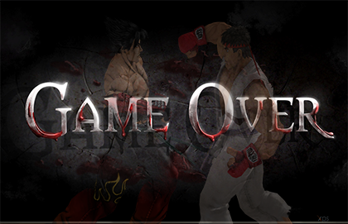
THE END

